Slide 1
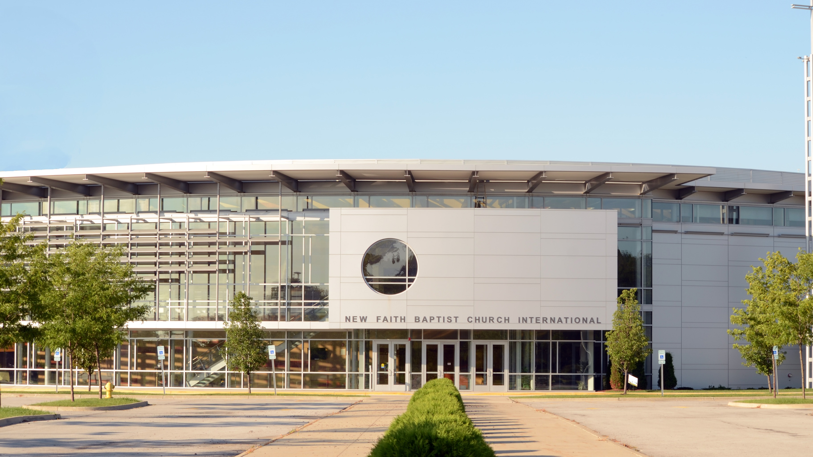
New Faith Baptist
Church International
Register for in-person Sunday service.
Sunday, Sep 5, 2021
10:00 a.m. CST
Reservation Form

