Slide 1
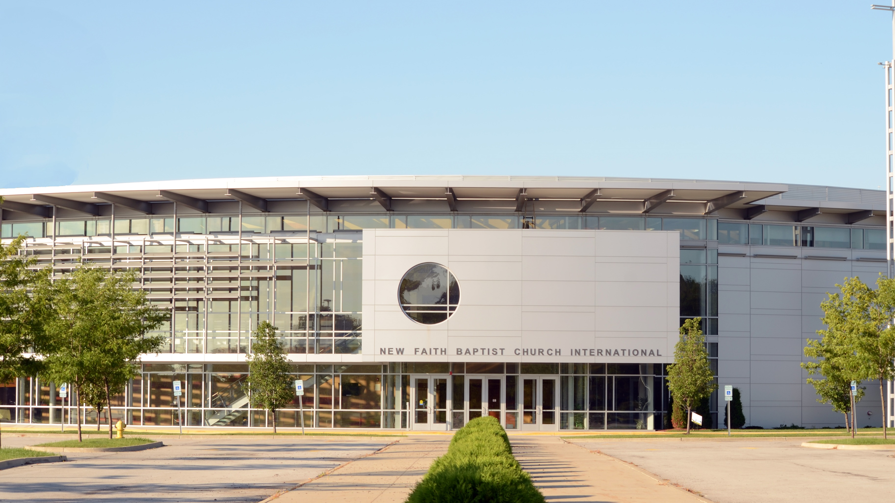
New Faith Baptist
Church International
Register for in-person Sunday service.
Sunday, Jan 16, 2022
10:00 a.m. CST
Reservation Form

